Slide 1
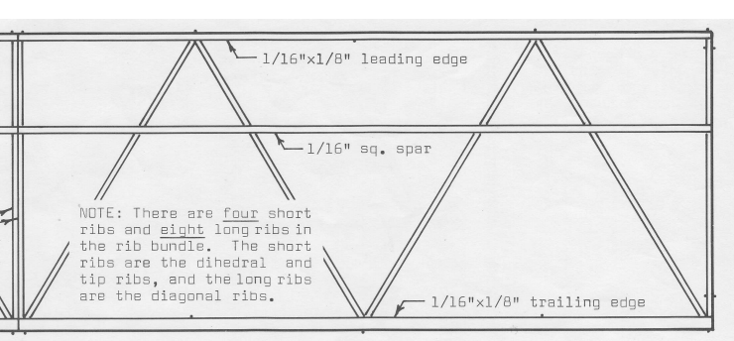
7 inches

Slide 2
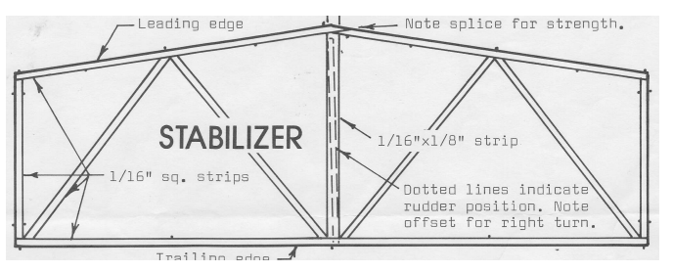
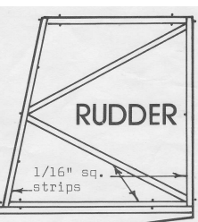
6.5 inches
3.31 inches
2.15 inches
Motor stick 3/8 x 1/8 x 15

